Slide 1
Asset Trader
Omer Orhan & Jun Wong

Slide 2

Introduction
Omer Orhan - Worked in Finance industry Can program in COBOL, Java, C# and Python
Jun Wong - Startup experience in virtual currency Missed out on Ethereum @ $.05 because he was too lazy to create a wallet

Slide 3
Asset Trading
Functionality;
New customer
Login Customer
Create Account
Deposit money
Withdraw money
Buy Asset
Sell Asset
List account

Slide 4
Use Case
Customer opens “Asset Trading Application” (AT). AT displays login page. Customer enters account name and password. AT displays ‘login successful’.
Customer selects Buy Asest. AT displays list of assets purchasable by customer. Customer chooses to purchase Bitcoin. AT displays Bitcoin to USD exchange rate and input field for quantity of Bitcoins to purchase. Customer inputs an amount of Bitcoins to purchase. AT displays total cost of Bitcoins in USD. Customer confirms purchase. AT debits USD from customers account, and credits customer’s Bitcoin account. Customer logs off.

Slide 5
OOP CONCEPTS
Factory Pattern
Inheritance
Encapsulation
Low Coupling
High Cohesion

Slide 6
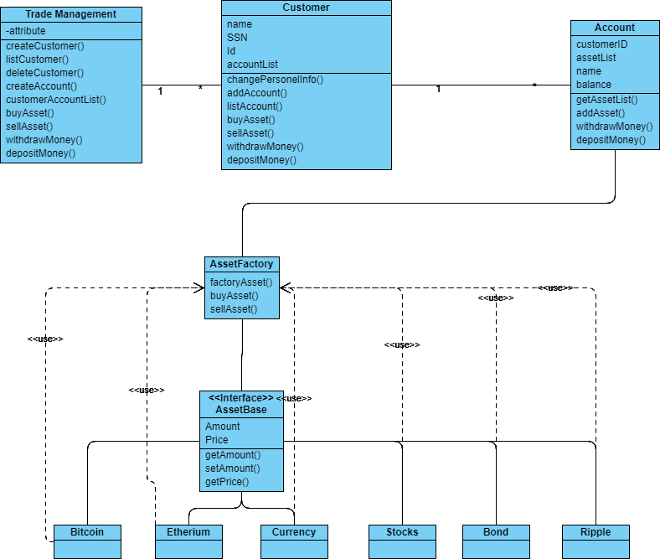
UML Diagram

Slide 7
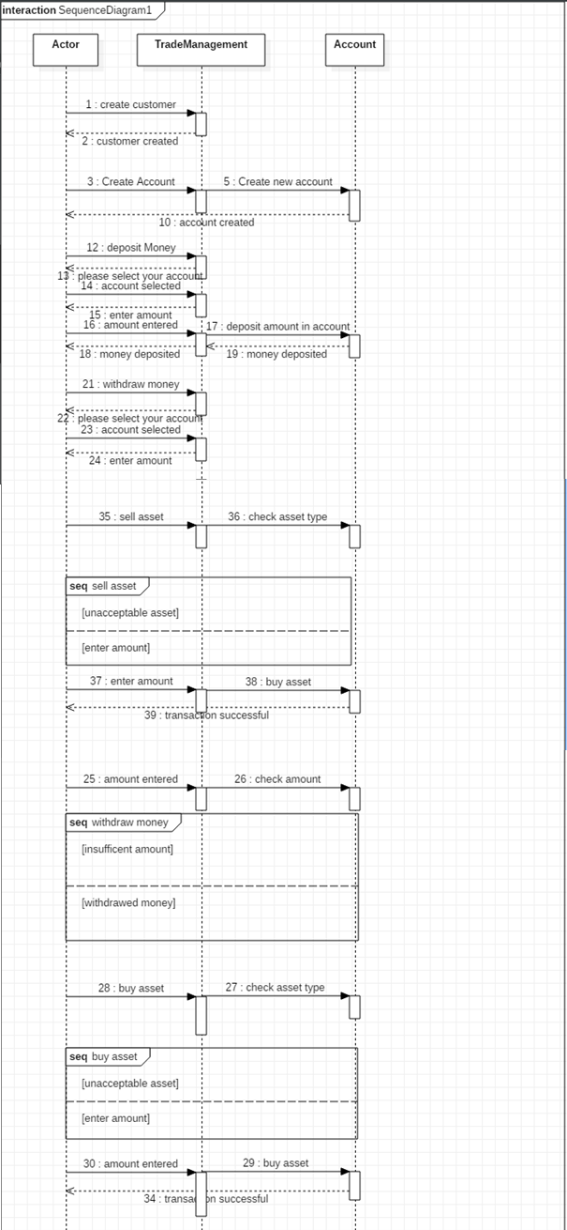
Sequence Diagram

Slide 8
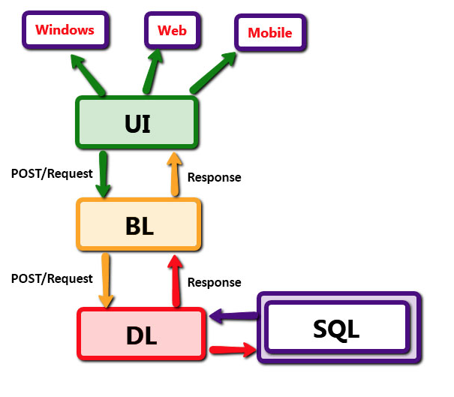
Architecture Diagram

Slide 9
Takeaways
Python code on windows does not compile on Mac !
Choice of project + Factory pattern == Infinite Classes
UI code last
Architectural Diagram most difficult - Very few examples

